Slide 1
Covid-19
Vinod Kumar Nethi Chinna

Slide 2
Covid-19 Information
Coronavirus disease (COVID-19) is an infectious disease caused by a new virus.
The disease causes respiratory illness (like the flu) with symptoms such as a cough, fever, and in more severe cases, difficulty breathing.
The disease was first identified in December 2019 in Wuhan, the capital of China’s Hubei province, and has since spread globally, resulting in the ongoing 2019-20 coronavirus pandemic.

Slide 3
Introduction
Analysis is done on the Covid-19 datasets based on April 1st.
The datasets are retrieved from Kaggle.
The first dataset include confirmed, recovered and death cases based by upon the countries.
The second dataset include the information of the patients. like Gender, Age , Address etc.
The third dataset is used for Naive Bayes to predict if the state of the confirmed patient (Isolated, Released, Deceased) based on Age, Gender and Country.
Download link : - https://www.Kaggle.Com/sudalairajkumar/novel-corona-virus-2019-dataset

Slide 4
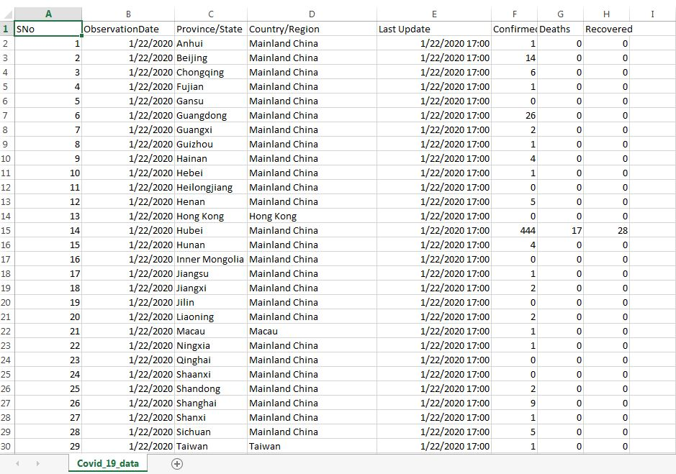
Dataset screenshots :- 1) Covid–19 dataset

Slide 5
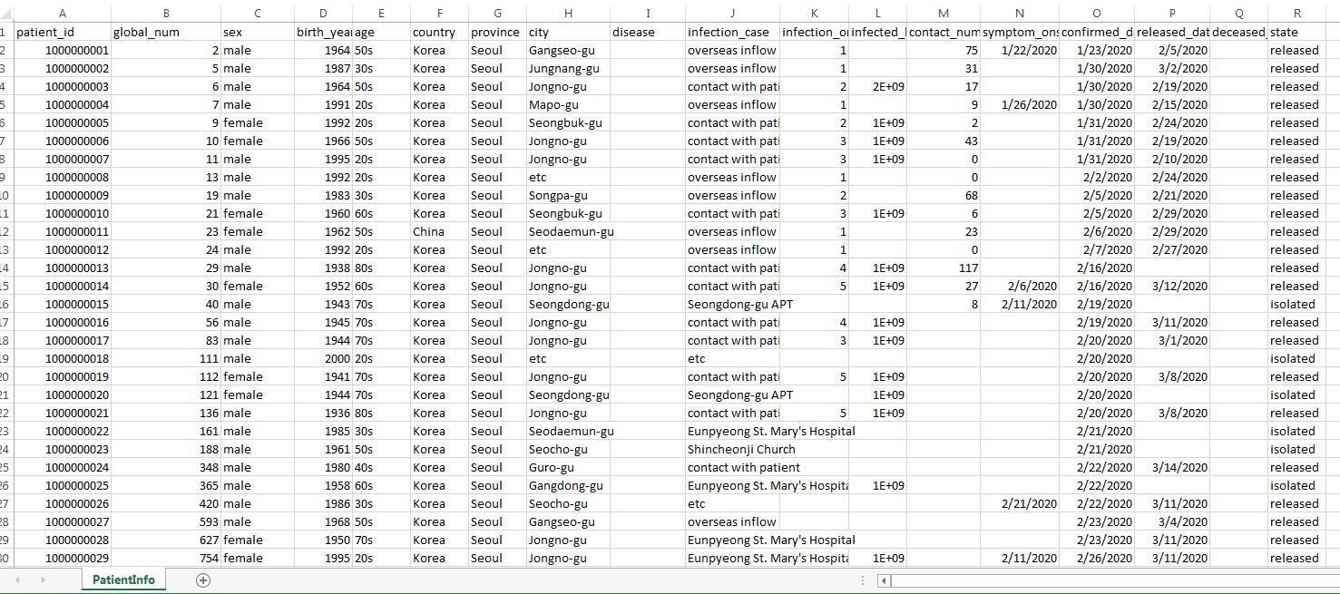
2) patient-Info dataset

Slide 6
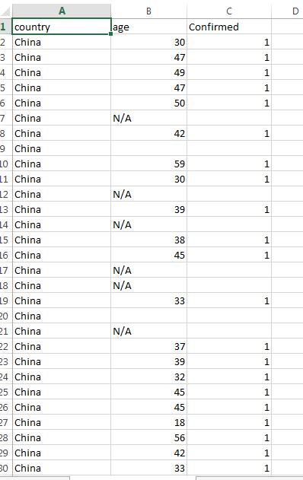
3)covid-19 countries info dataset

Slide 7
Data Discovery :-
The above used datasets are retrieved from Kaggle.
Data Preparation : -
Tableau and PowerBI is used to Clean data. ( removing nulls, replacing N/A Values, Some Garbage data are replaced)
EXCEL is also used for Minor modifications to the data files.

Slide 8
Data Model Used : -
Clustering in Tableau
Classification using Naïve Bayes.
Visualization Tools Used: -
R-Studio(Naive Bayes)
Tableau(Clustering and Data Cleanup)
PowerBI (Data Cleanup and Visualization)

Slide 9
Clustering using Tableau
Three Clusters :-
Cluster 1: (Age vs Confirmed)
Cluster 2: (Country vs Confirmed)
Cluster 3: (Confirmed Vs Deaths)
For clustering, we have linear values
for most of our data. We tried
making multiple clusters with different attributes.

Slide 10
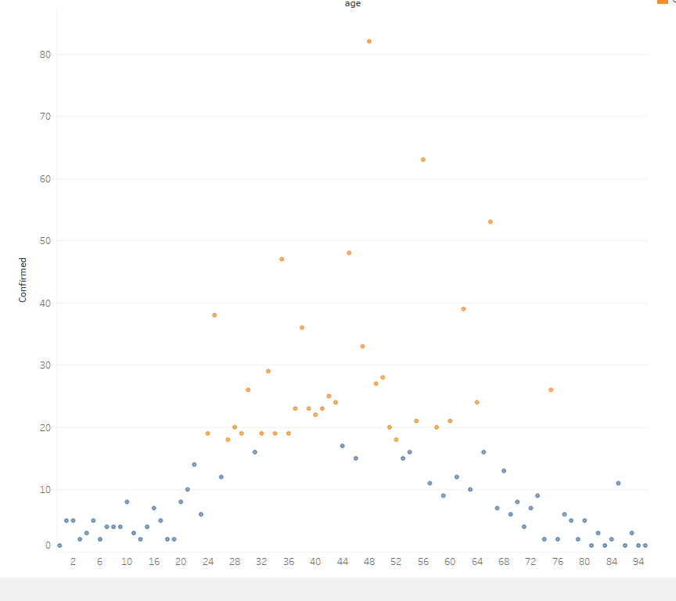
1)CLUSTER 1 (AGE VS CONFIRMED CASES)

Slide 11
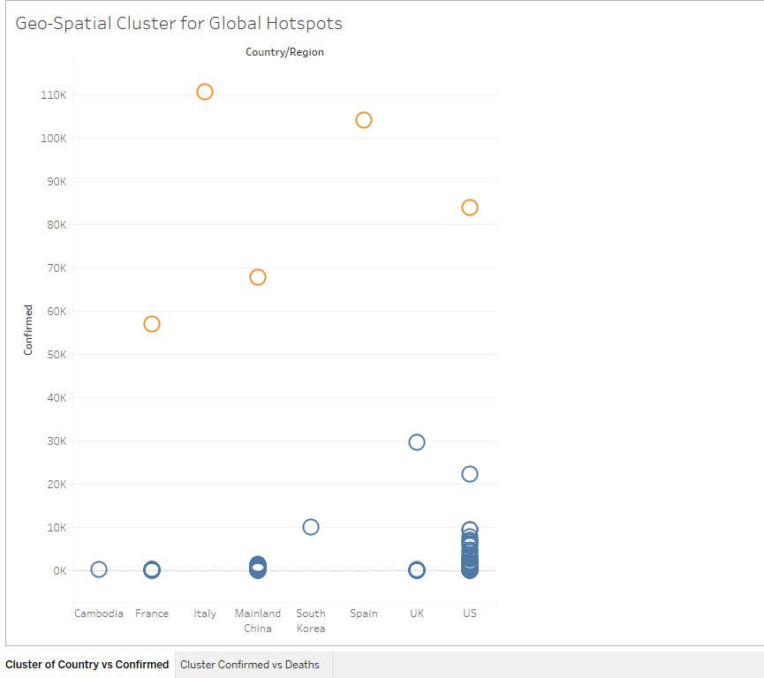
2)CLUSTER 2 (COUNTRY VS CONFIRMED)

Slide 12
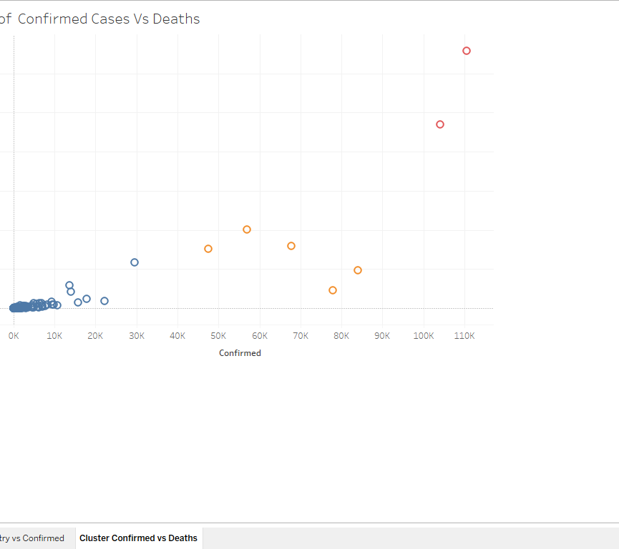
3)CLUSTER 3 (AGE VS CONFIRMED CASES)

Slide 13
Visualization in PowerBI
Confirmed cases by country
Recovery Rate for top 10 Countries
Death Rate for Global Hotspots

Slide 14
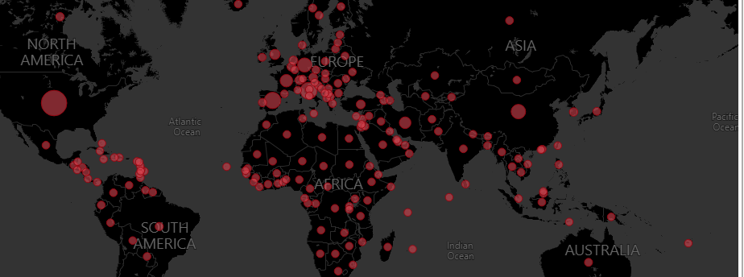
1) Confirmed cases by country
In this chart, the countries with most confirmed cases have the biggest circle to represent the cases, As you can see the highest cases are in USA, China, Italy, Spain.

Slide 15
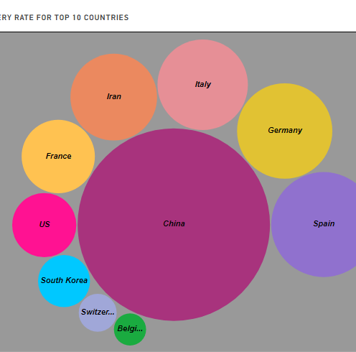
2) Recovery Rate for top 10 Countries
In this chart, The countries are arranged on the total recovered cases of Covid-19. The biggest circle represent China followed by Italy, Germany etc.

Slide 16
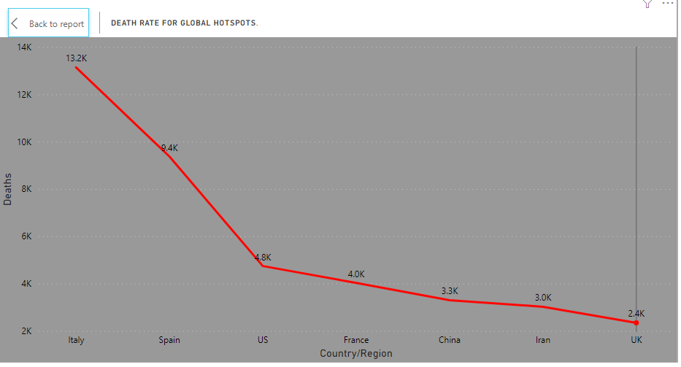
3) Death Rate for Global Hotspots
In this Line Chart, the line represent the death cases in Top 10 countries with the most cases, Italy has more than 12K death, followed by Spain and USA.

Slide 17
Classification model
Using Naive Bayes
Download link : https://www.kaggle.com/kimjihoo/coronavirusdataset#PatientInfo.csv

Slide 18
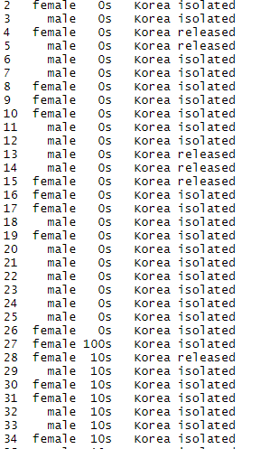
Traindata
For Naive Bayes, we took a different file. Which will predict the State(Isolated, Released, Deceased) of a COVID infected patient. To predict it we took Age, Sex and Country in our TestData.

Slide 19
TestData

Slide 20
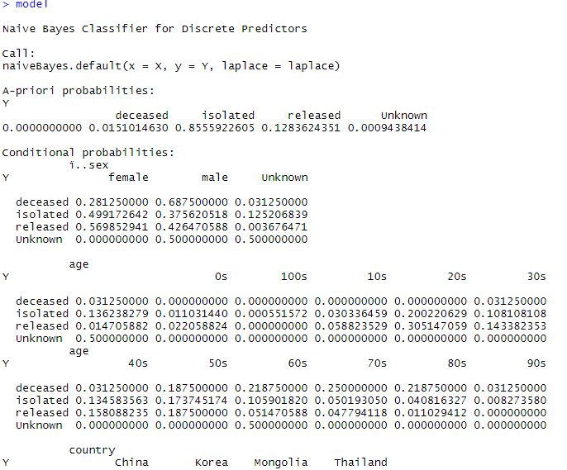
Model

Slide 21

Results

Slide 22
R studio Code used in Naïve Bayes
setwd('C:/Users/Vinod/Desktop/Data Analytics Project')
sample<-read.table("Input_For_NaiveBayes.csv",header = TRUE,sep = ",")
traindata<-as.data.frame(sample[1:2119,])
testdata<-as.data.frame(sample[2120,])
install.packages("e1071", dep = TRUE)
library(e1071)
model<-naiveBayes(state~ï..sex+age+country,traindata)
results<-predict(model,testdata)
results

Slide 23
Conclusion
Most confirmed cases are in USA, Italy, Spain and China.
Italy has the most deaths in all of infected Countries.
China has the highest number of recovered cases.
Older people are most likely to get infected and have the higher risk of losing their life than younger people, based on the prediction on the third dataset.

